Slide 1
DIAGNOSIS OF PARASITIC INFECTIONS
Unit 2
2.1 Specimen in which parasites are found
1. Faeces/Stool
Protozoan parasites, depending on type of parasite
Cyst
Amoeba
Flagellate
Ciliate
Oocyst

Slide 2
Faeces/Stool (Cont’d.)
For some parasites both their cyst and amoeba, or cyst and flagellate or cyst and ciliate may be found

Slide 3
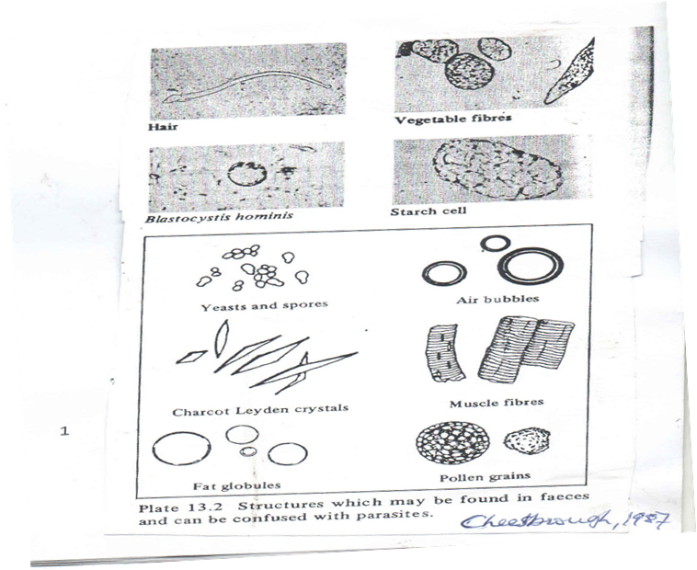
Structures found in faeces that may be confused with parasites

Slide 4
Faeces/Stool (Cont’d.)
Helminth parasites, depending on the type of parasites
Egg
Segment
Egg capsule
Worm
Larva

Slide 5
Faeces/Stool (Cont’d.)
For some parasites both their egg and segment or egg and capsule or egg and worm may be found

Slide 6
Specimen in which parasites are found (Cont’d.)
2. Blood
Protozoan parasites
Trophozoite
Schizont
Gametocyte
Trypomastigote
Helminth parasites (Nematodes)
Microfilaria

Slide 7
Specimen in which parasites are found (Cont’d.)
3. Urine
Protozoan parasites
Flagellate (rarely)
Helminth parasites
Egg
Microfilaria (rarely)

Slide 8
Specimen in which parasites are found (Cont’d.)
4. Sputum
Helminth parasite
Egg
Flukes (occasionally)

Slide 9
Specimen in which parasites are found (Cont’d.)
5. Cerebrospinal fluid
Protozoan parasites
Trypomastigote
Amoeba

Slide 10
Specimen in which parasites are found (Cont’d.)
6. Bone marrow
Protozoan parasites
Amastigote
Toxoplasm

Slide 11
Specimen in which parasites are found (Cont’d.)
7. Lymph gland Aspirate
Protozoan parasites
Trypomastigote
Amastigote
Toxoplasm

Slide 12
Specimen in which parasites are found (Cont’d.)
8. Liver Aspirate
Protozoan parasites
Amoeba
Amastigote
Toxoplasm

Slide 13
Specimen in which parasites are found (Cont’d.)
9. Spleen aspirate
Protozoan parasites
Amastigote
Toxoplasm

Slide 14
Specimen in which parasites are found (Cont’d.)
10. Skin
Protozoan parasites
Amastigote
Helminth parasites
Microfilaria
Larva in ulcer fluid
Egg on perianal skin

Slide 15
Specimen in which parasites are found (Cont’d.)
11. Muscle
Helminth parasites
Larvae

Slide 16
Specimen in which parasites are found (Cont’d.)
12. Rectal Scraping
Protozoan parasites
Amoeba
Helminth parasites
Egg

Slide 17
Specimen in which parasites are found (Cont’d.)
13.Duodenal Aspirate
Protozoan parasites
Flagellates
Helminth parasites
Egg
lava

Slide 18
Methods used in diagnosis
1. Microscopic examination
For majority of intestinal, urinary and blood parasites in stained or unstained preparations
The preparations may be viewed directly or following concentration (when the parasites are few)

Slide 19
2. Cultural techniques
Few parasitic infections are diagnosed routinely by cultural techniques
For example stool or faecal culture (Coproculture) to enable distinguishing of nematode specimens;
the method is necessary for identifying e.g. hookworm specimens (Ancylostoma sp; Necator sp., Oesophagostomum sp.).

Slide 20
2. Cultural techniques (Cont’d.)
Culture of the faecal specimen leads to hatching of the eggs which develop to the L₃ larval stage when the worms can be identified on the basis of their unique larval features.

Slide 21
3. Immunodiagnostic techniques
These are used when:
Parasites are in the tissues of internal organs and cannot be easily removed for examination
Parasites can be found in specimens only in certain stages of an infection (e.g. in the acute, and not in the chronic stage)
Parasites are present only intermittently or in too few numbers to be easily detected in specimens

Slide 22
3. Immunodiagnostic techniques (Cont’d.)
The techniques used are generally complex or time-consuming
Parasitic diseases for which immunodiagnosis is of particular value include:
Trypanosomiasis
Leishmaniasis

Slide 23
3. Immunodiagnostic techniques (Cont’d.)
Amoebic Liver abscess
Toxoplasmosis
Hydatid disease
Filariasis (Occult and chronic infections)

Slide 24
3. Immunodiagnostic techniques (Cont’d.)
Trichinellosis
Toxocariasis
Schistosomiasis (chronic stage)

Slide 25
3. Immunodiagnostic techniques (Cont’d.)
Immunodiagnostic techniques are based on the detection of:
Antibody in a person’s serum, produced in response to a particular parasitic infection.
The antibody may persist for a long period in the serum after an infection has ended hence the tests do not indicate whether the infection is current or long ago.
Antibody tests need to be interpreted with care.

Slide 26
3. Immunodiagnostic techniques (Cont’d.)
Antigen, which is excreted by parasites and can be found in serum, urine, cerebrospinal fluid, faeces or other specimens.
Antigen tests provide evidence of present infection and are therefore of greater value than antibody tests in clinical diagnosis of parasitic infections.

Slide 27
3. Immunodiagnostic techniques (Cont’d.)
In a few parasitic infections the demonstration of IgM antibody helps to indicate whether an infection is a recent one, e.g. Toxoplasmosis.

Slide 28
3. Immunodiagnostic techniques (Cont’d.)
Testing for a rising antibody titre can be of value in indicating whether an infection is an active one and in some sensitive tests, changes in antibody titre can indicate whether a patient is responding to treatment.

Slide 29
3. Immunodiagnostic techniques (Cont’d.)
Interpretation of antibody test results needs care because false positive reactions may occur due to cross-reactions with other human and animal parasitic antigens.
Different helminthes share many antigens and hence species-specific diagnosis is not always possible. False negative results may occur due to an excess of antigen removing the antibody

Slide 30
Antibody/Serological Tests
These include:
Rapid Slide Agglutination Test (RSA test)
Gel or Cellulose Acetate Precipitin Test (GCAPT)
Indirect Haemaglutination Test (IHT)
Complement Fixation Test (CFT)
Indirect Fluorescent Antibody Test (IFAT) and
Enzyme-linked Immunosorbent Assay (ELISA)

Slide 31
Antibody/Serological Tests (Cont’d.)
The choice of technique depends on a number of factors, including the
  Parasitic infection under investigation
  The number of tests
  The availability of reagents
  Sensitivity and specificity of the test system and
  The ability and facilities available in the laboratory.

Slide 32
Antibody/Serological Tests (Cont’d.)
The ELISA has become a standard technique in the diagnosis and epidemiological studies of the important parasitic diseases. It can be used to detect antibody or antigen.
ELISA can be used to diagnose malaria, amoebiasis, schistosomiasis, onchocerciasis, toxoplasmosis, echinococcosis, trypanosomiasis, leishmaniasis and trichinellosis.

Slide 33
Antibody/Serological Tests (Cont’d.)
ELISA tends to be more sensitive and specific than other serological tests, provides a quantitative result using a single serum dilution and can be automated in a central immunodiagnostic laboratory.

Slide 34
Sources of Antigens for Serological Tests
Usually, most laboratories prepare their own antigens from parasites grown in cultures or developed in laboratory animals.
Only a few antigens are available from commercial sources but these may be very expensive and have only short shelf-lives

Slide 35
Sources of Antigens for Serological Tests (Cont’d.)
Two new techniques which are developing rapidly and expected to provide specific antigens for serological tests are
Monoclonal techniques and
Recombinant techniques

Slide 36
Monoclonal Antibodies
These are made by fusing antibody producing lymphocytes (B lymphocytes) from an immunized mouse, with a mouse myeloma cell line.
Clones of the resultant hybridomas retain both the capacity to produce the particular antibody made by the lymphocyte and also the capacity for indefinite growth in vitro.

Slide 37
Monoclonal Antibodies (Cont’d.)
This allows the production in vitro of large quantities of a range of antibodies, each being usually against a narrow range of antigens.
If the antigens which are useful in immuno-diagnosis can be identified, the appropriate monoclonal can be used to extract and purify it, e.g. by affinity chromatography.

Slide 38
Recombinant DNA (DNA probes)
This technique involves, firstly, extracting and fragmenting the DNA from one organism and hybridizing (incorporating) this with DNA fragments from another organism.

Slide 39
Recombinant DNA (Cont’d.)
The resulting hybrids are then reinserted into the latter organism which is known as the vector.
This is usually a virus or a bacterial plasmid, nearly always from E. coli, which is able to replicate itself very rapidly, thereby producing large quantities of the proteins.
For example, the DNA coding for an antigenic protein in a parasite could be inserted into E. coli, which, by its rapid replication, would yield large quantities of this protein.

Slide 40
Antigen Test
Monoclonal techniques are also used to develop highly reactive and specific antibody reagents, especially for ELISA (Sandwich assay).

Slide 41
Other Tests for identification of some parasites
Biochemical tests to detect isoenzyme and genetic characteristics.
Enzyme electrophoresis

Slide 42
Definition of Terms for Diagnostic Stages
Amastigote: the non-flagellate, intracellular, morphologic stage in the development of certain haemoflagellates, resembling the typical adult form of Leishmania.
Oocyst: the encysted or encapsulated ookinete (the fertilized form of the malarial parasite in the body of a mosquito); it is formed by fertilization of a macrogamete by a microgamete and develops into an oocyst.

Slide 43
Definition of Terms for Diagnostic Stages (Cont’d.)
Trophozoite: the active, motile, feeding stage of a protozoan organism.
Trypomastigote: a morphological stage in the development of certain haemoflagellates, resembling the typical adult form of Trypanosoma and characterized by having a flagellum

Slide 44
Definition of Terms for Diagnostic Stages (Cont’d.)
Schizonts: the stage in the development of the malarial parasite, Plasmodium, following the trophozoite, whose nucleus divides into many smaller nuclei, followed by the division of the cytoplasm to surround each nucleus,
thus forming a merozoite (merozoites).
Microfilaria: the prelarval stage of the Filarioidea in the blood of humans and in the tissues of the vector.

Slide 45
Definition of Terms for Diagnostic Stages (Cont’d.)
Toxoplasm: the immature stage of Toxoplasma sp. that may be found in stained preparations of body fluids such as lymph node/gland, liver or spleen aspirates or bone marrow.

